Slide 1

HOW TO DISPLAY IN A SHOW
OR AT HOME
PRESENTED BY WES LINGERFELT
JULY 9, 2024

Slide 2
WHY DISPLAY YOUR ART WORK?
You want to show off your skills!
You are proud of your crafting ideas!
You want to enhance Mother Nature’s beauty and share it!
You want to win awards (Ribbons & $)

Slide 3
There are two types of displays:
Non-Competition( No Judging)
Competition (entered to be judged)
There are two systems for judging:
The American System & The Danish System.

Slide 4
WHERE CAN YOU DISPLAY YOUR ART?
A LOCAL CLUB GEM SHOW
Competition Governed by AFMS Rules
2. A COUNTY AGRICULTURAL FAIR
Competition Governed by State Rules
3. In your own home

Slide 5
What type of display cases are there?
The Federation Case (24”d x 48”w x 30”t)
The Slant Case (Various Sizes)
The Upright Case (Various Sizes)

Slide 6
Displaying lapidary art can be both functional and visually appealing. Here are some creative ideas:
Shadow Boxes: Arrange your polished stones, minerals, or jewelry pieces in shadow boxes with a velvet or felt background. You can add labels or descriptions to each specimen.
Floating Shelves: Install floating shelves on a wall and place your lapidary creations on them. The “floating” effect adds a modern touch.

Slide 7
Glass Cloches or Domes: Place individual stones or small sculptures under glass cloches or domes. These protect the pieces while allowing them to be admired.
Custom Frames: Frame slices of agate, jasper, or other colorful stones. You can create a gallery wall with various framed pieces.
Natural Wood Stumps: Use hollowed-out tree stumps or branches as display stands. They provide an organic, rustic look.

Slide 8
Geode Bookends: Geodes split in half make stunning bookends. They hold your books while showcasing their beautiful crystal interiors.
Lapidary Jewelry Trees: Craft or purchase jewelry trees made from wire or metal. Hang necklaces, bracelets, and earrings on the branches.
Remember to consider lighting, background colors, and overall aesthetics when choosing your display method. Enjoy showcasing your lapidary art!

Slide 9
Organizing your lapidary collection is essential for easy access and protection. Here are some tips:
Group by Species: Separate your gems into piles by species. Use jeweler’s tweezers to handle them and avoid soiling. Identify fragile stones and wrap them in jeweler’s tissue paper

Slide 10
Storage and Display Cases:
  Consider gemstone organizers with pullout drawers or display cases with glass tops.
  Use gemstone jars with foam inserts inside these cases for extra protection.
  Plastic containers with dividers are practical and inexpensive options.

Slide 11
Parcel Paper Organizers:
  Store pieces in industry-standard gemstone parcel papers (acid-free envelopes).
  Label the papers to identify contents and enhance color play with different liners.
Traveling Containers:
  For frequent travelers, use lightweight storage containers or specially designed gemstone cases.
Remember to clean your gemstones before storage. Proper care ensures their longevity and beauty!

Slide 12
Remember to consider lighting, background colors, and overall aesthetics when choosing your display method. Enjoy showcasing your lapidary art!

Slide 13
Making your own jewelry displays can be both fun and practical. Here are creative DIY ideas to showcase your beautiful pieces:
DIY Jewelry Organizer:
If you have a vast jewelry collection, make a roomy cabinet to store and display your pieces.
Driftwood Necklace Holder:
Attach decorative knobs to a piece of driftwood or a flat board. Hang your necklaces stylishly.

Slide 14
Industrial Pipe Jewelry Organizer:
Use PVC pipes or industrial pipes to create a vertical jewelry organizer. Efficient and trendy!
Tiered Jewelry Display:
Build a tiered jewelry organizer for a chic and organized look. (Often called a riser)

Slide 15
Fabric-Covered Foam Board Necklace Display:
Make an upright necklace display using fabric-covered foam board. Easy to choose your daily accessory.

Slide 16
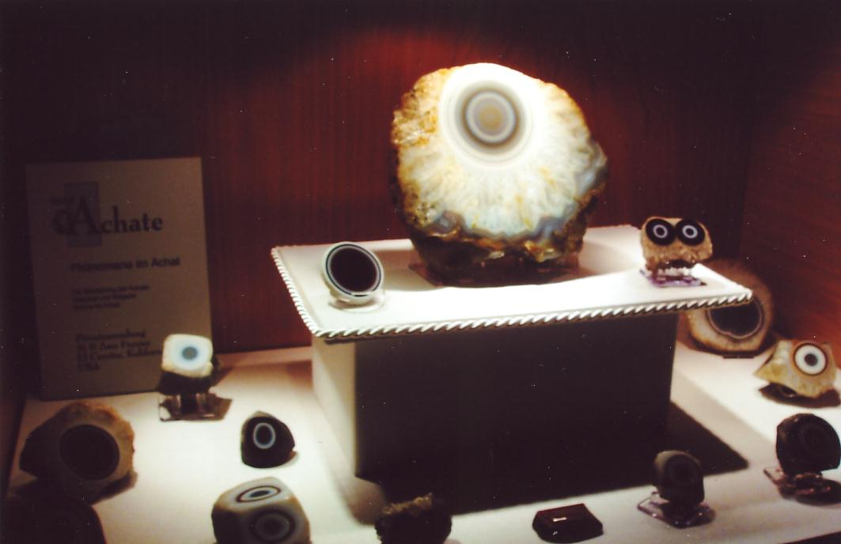

Slide 17
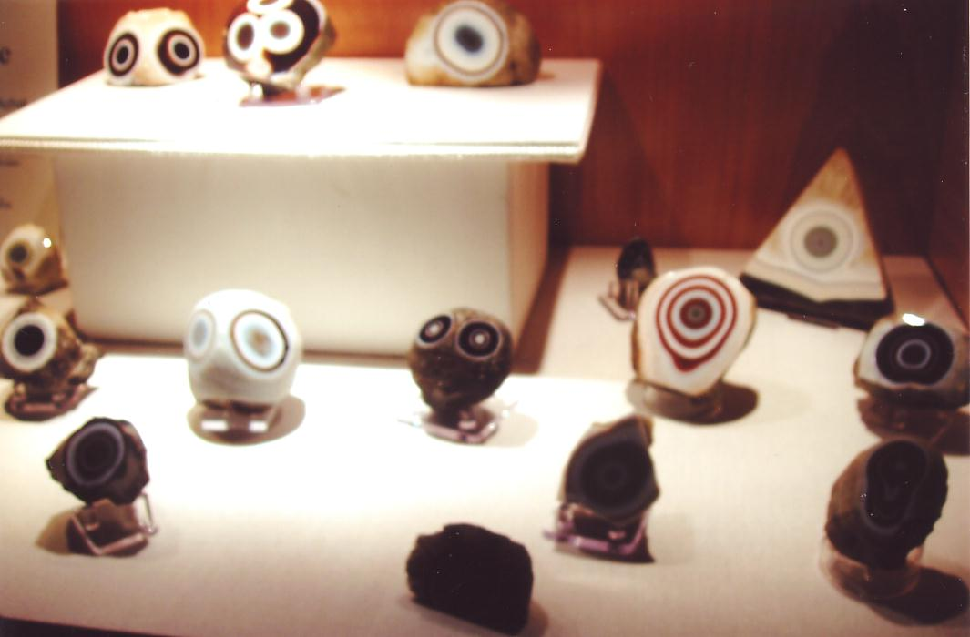

Slide 18
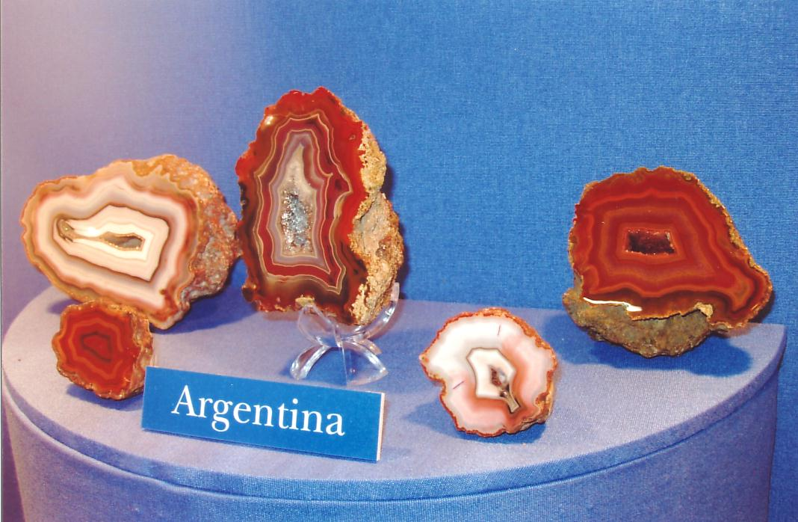

Slide 19
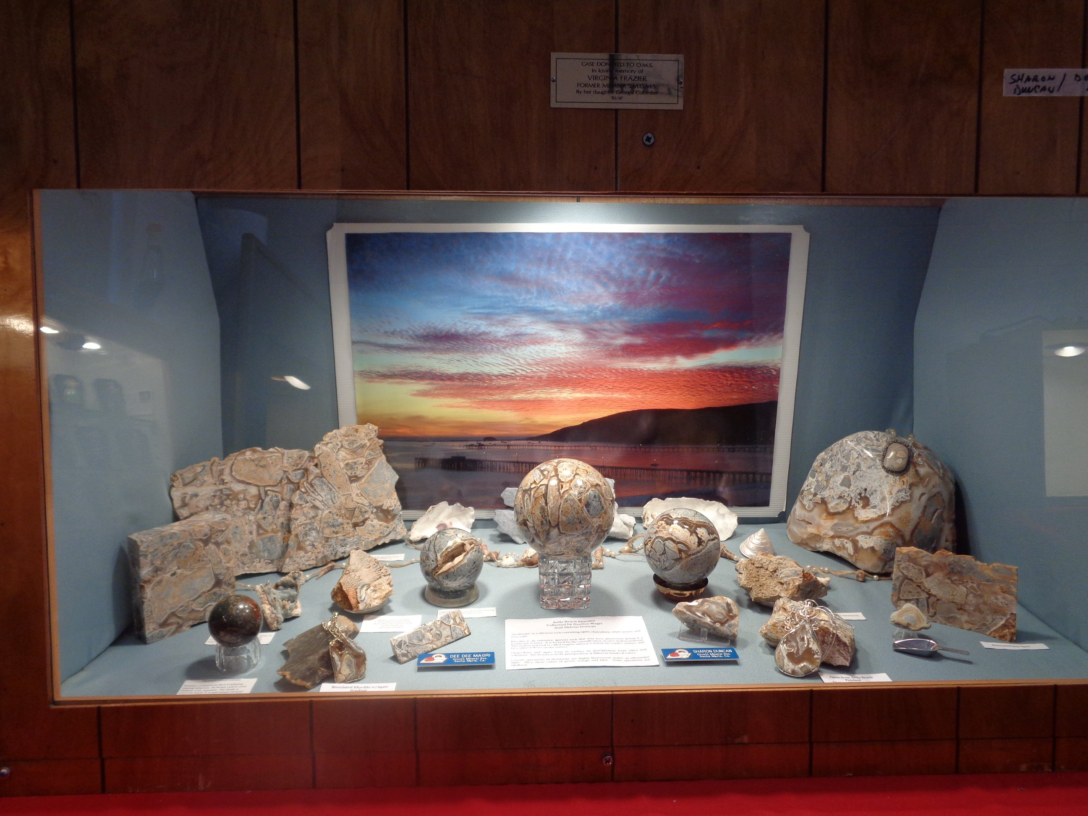

Slide 20
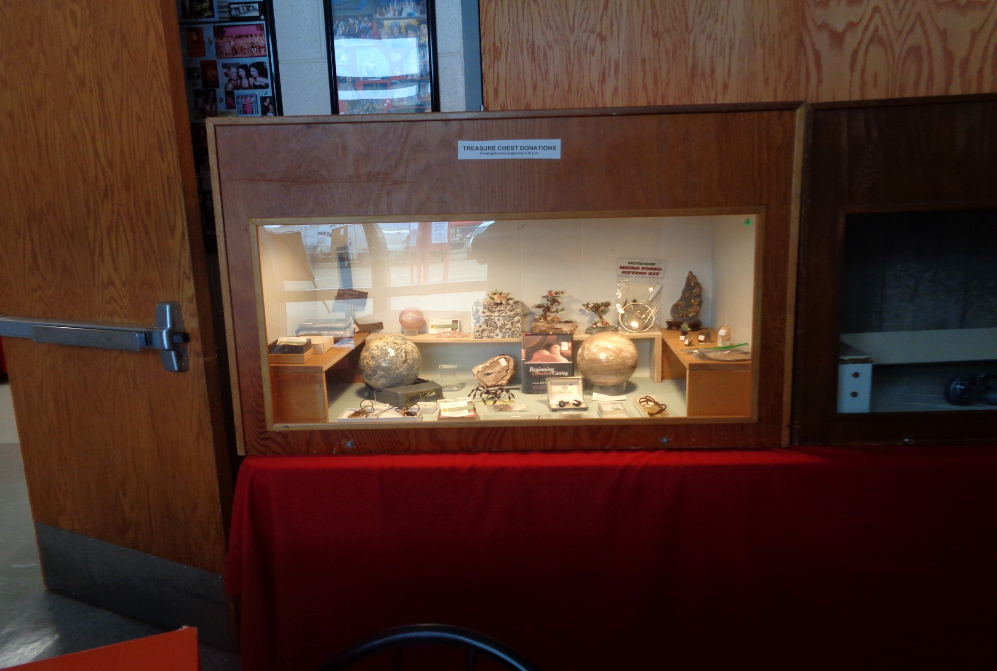

Slide 21
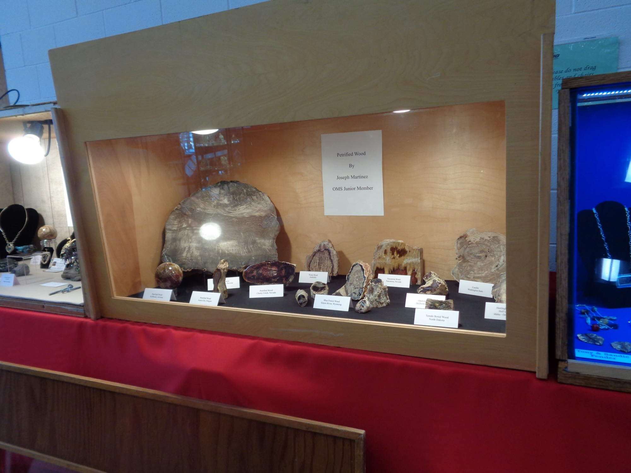

Slide 22
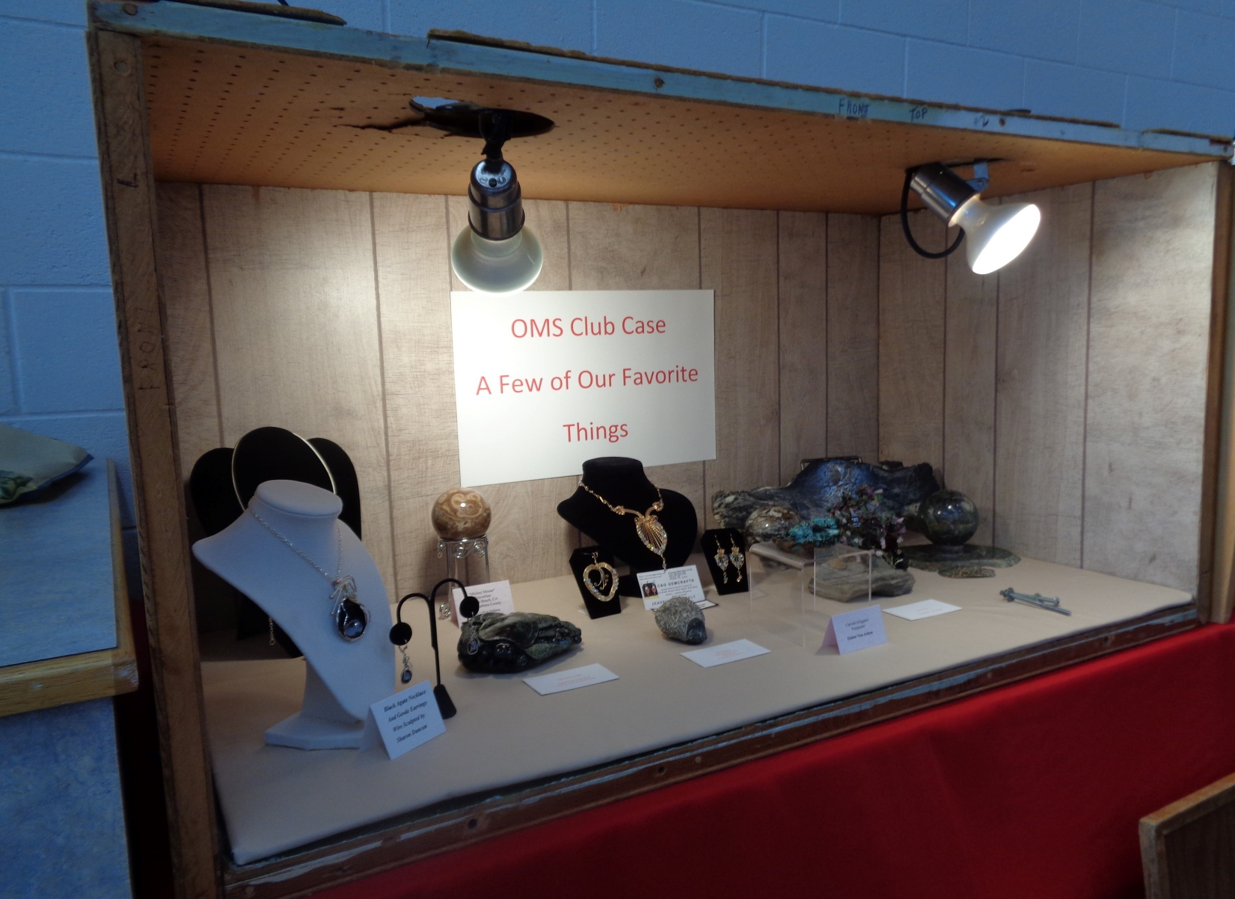

Slide 23
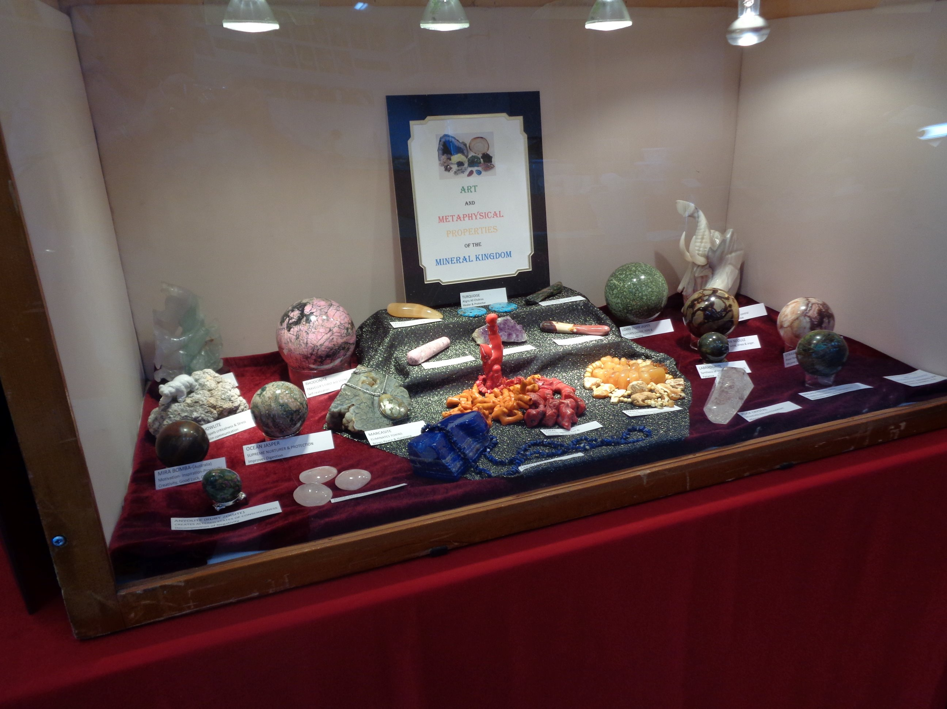

Slide 24
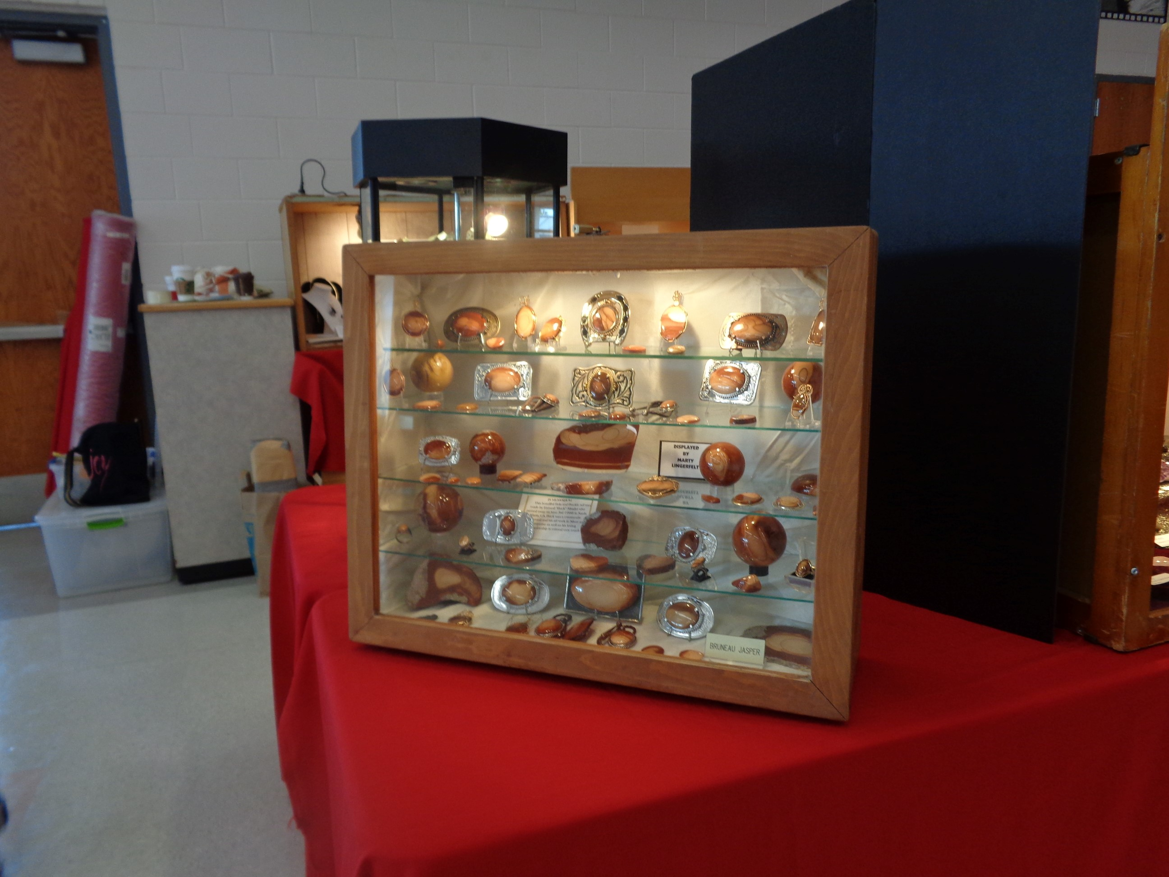

Slide 25
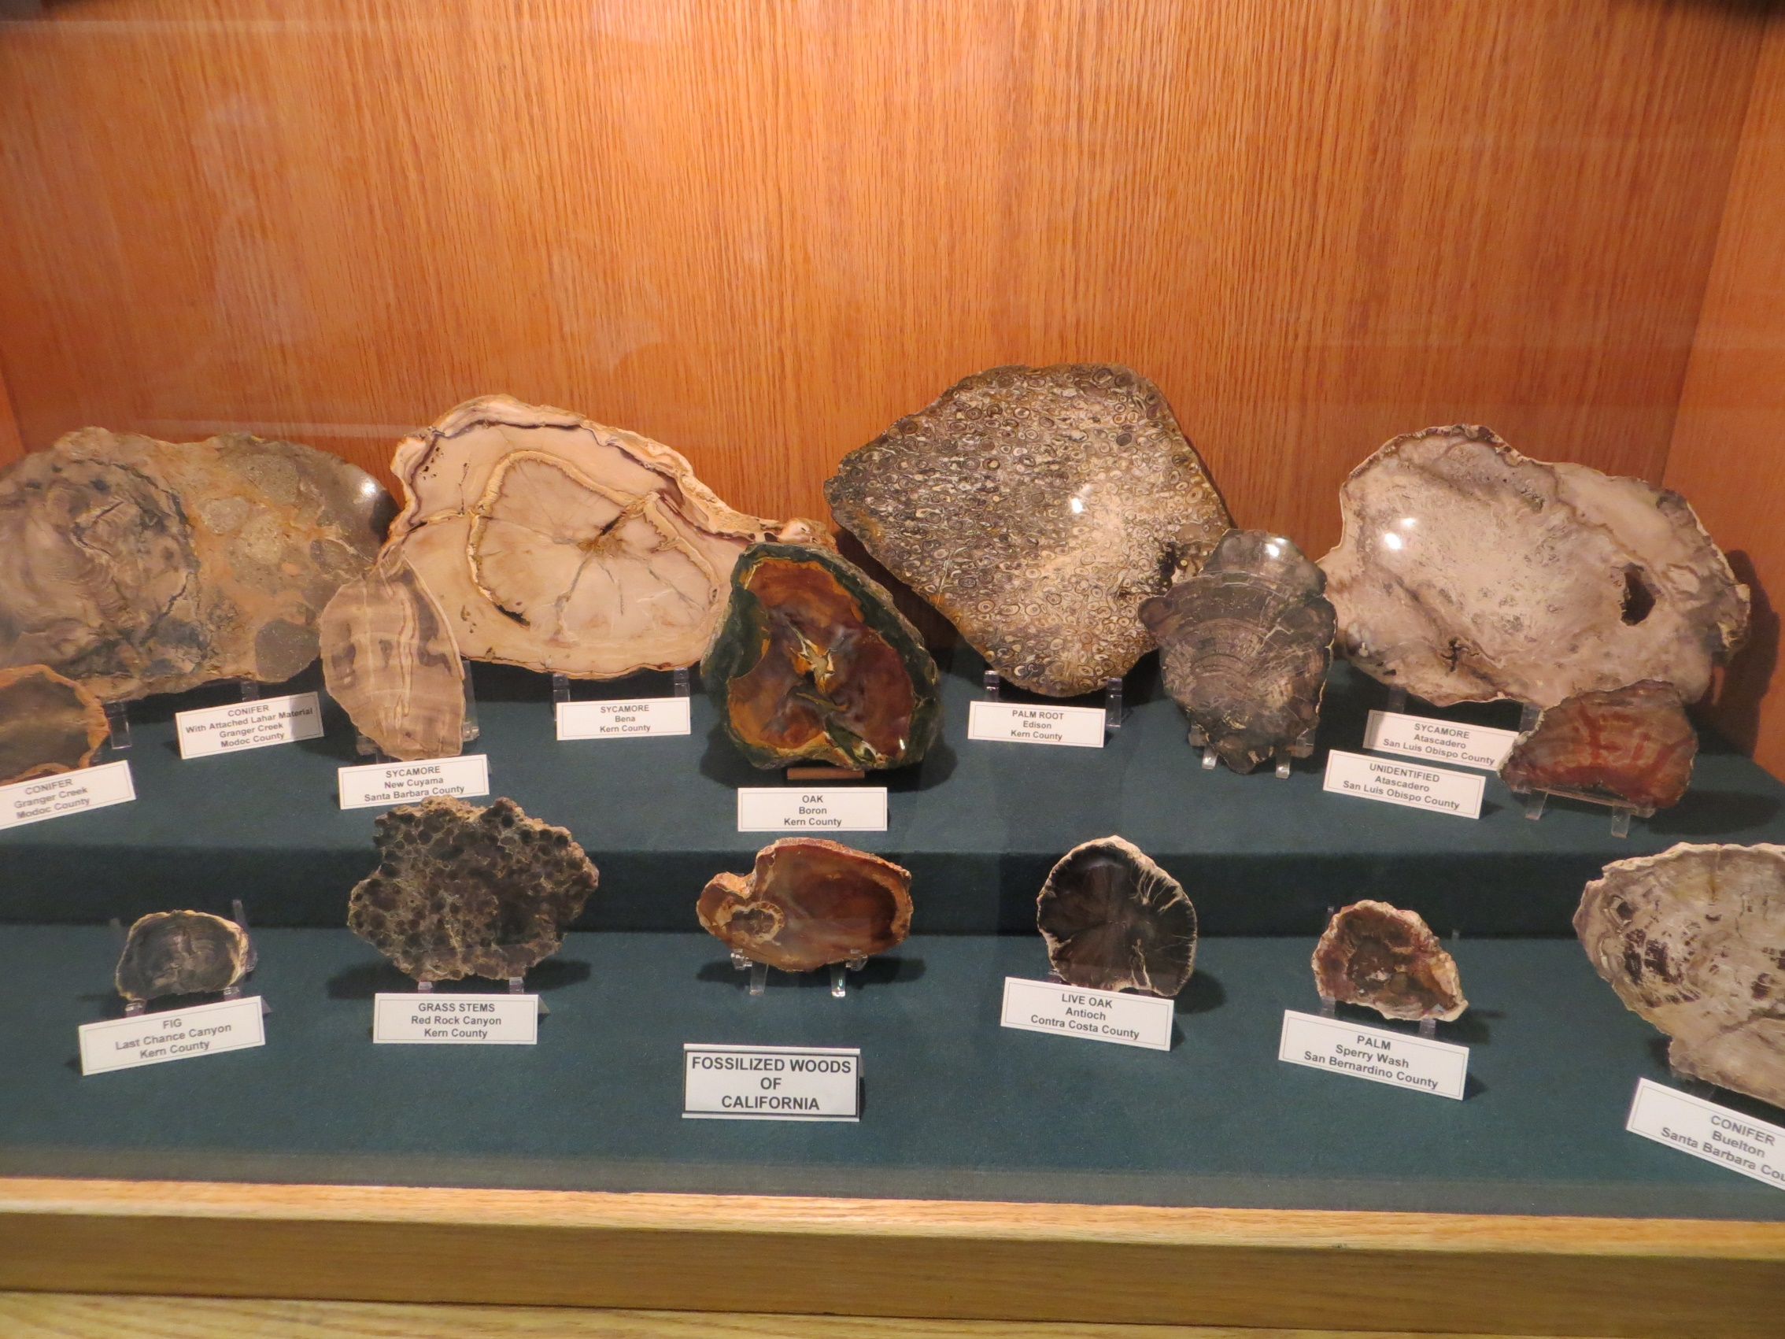

Slide 26
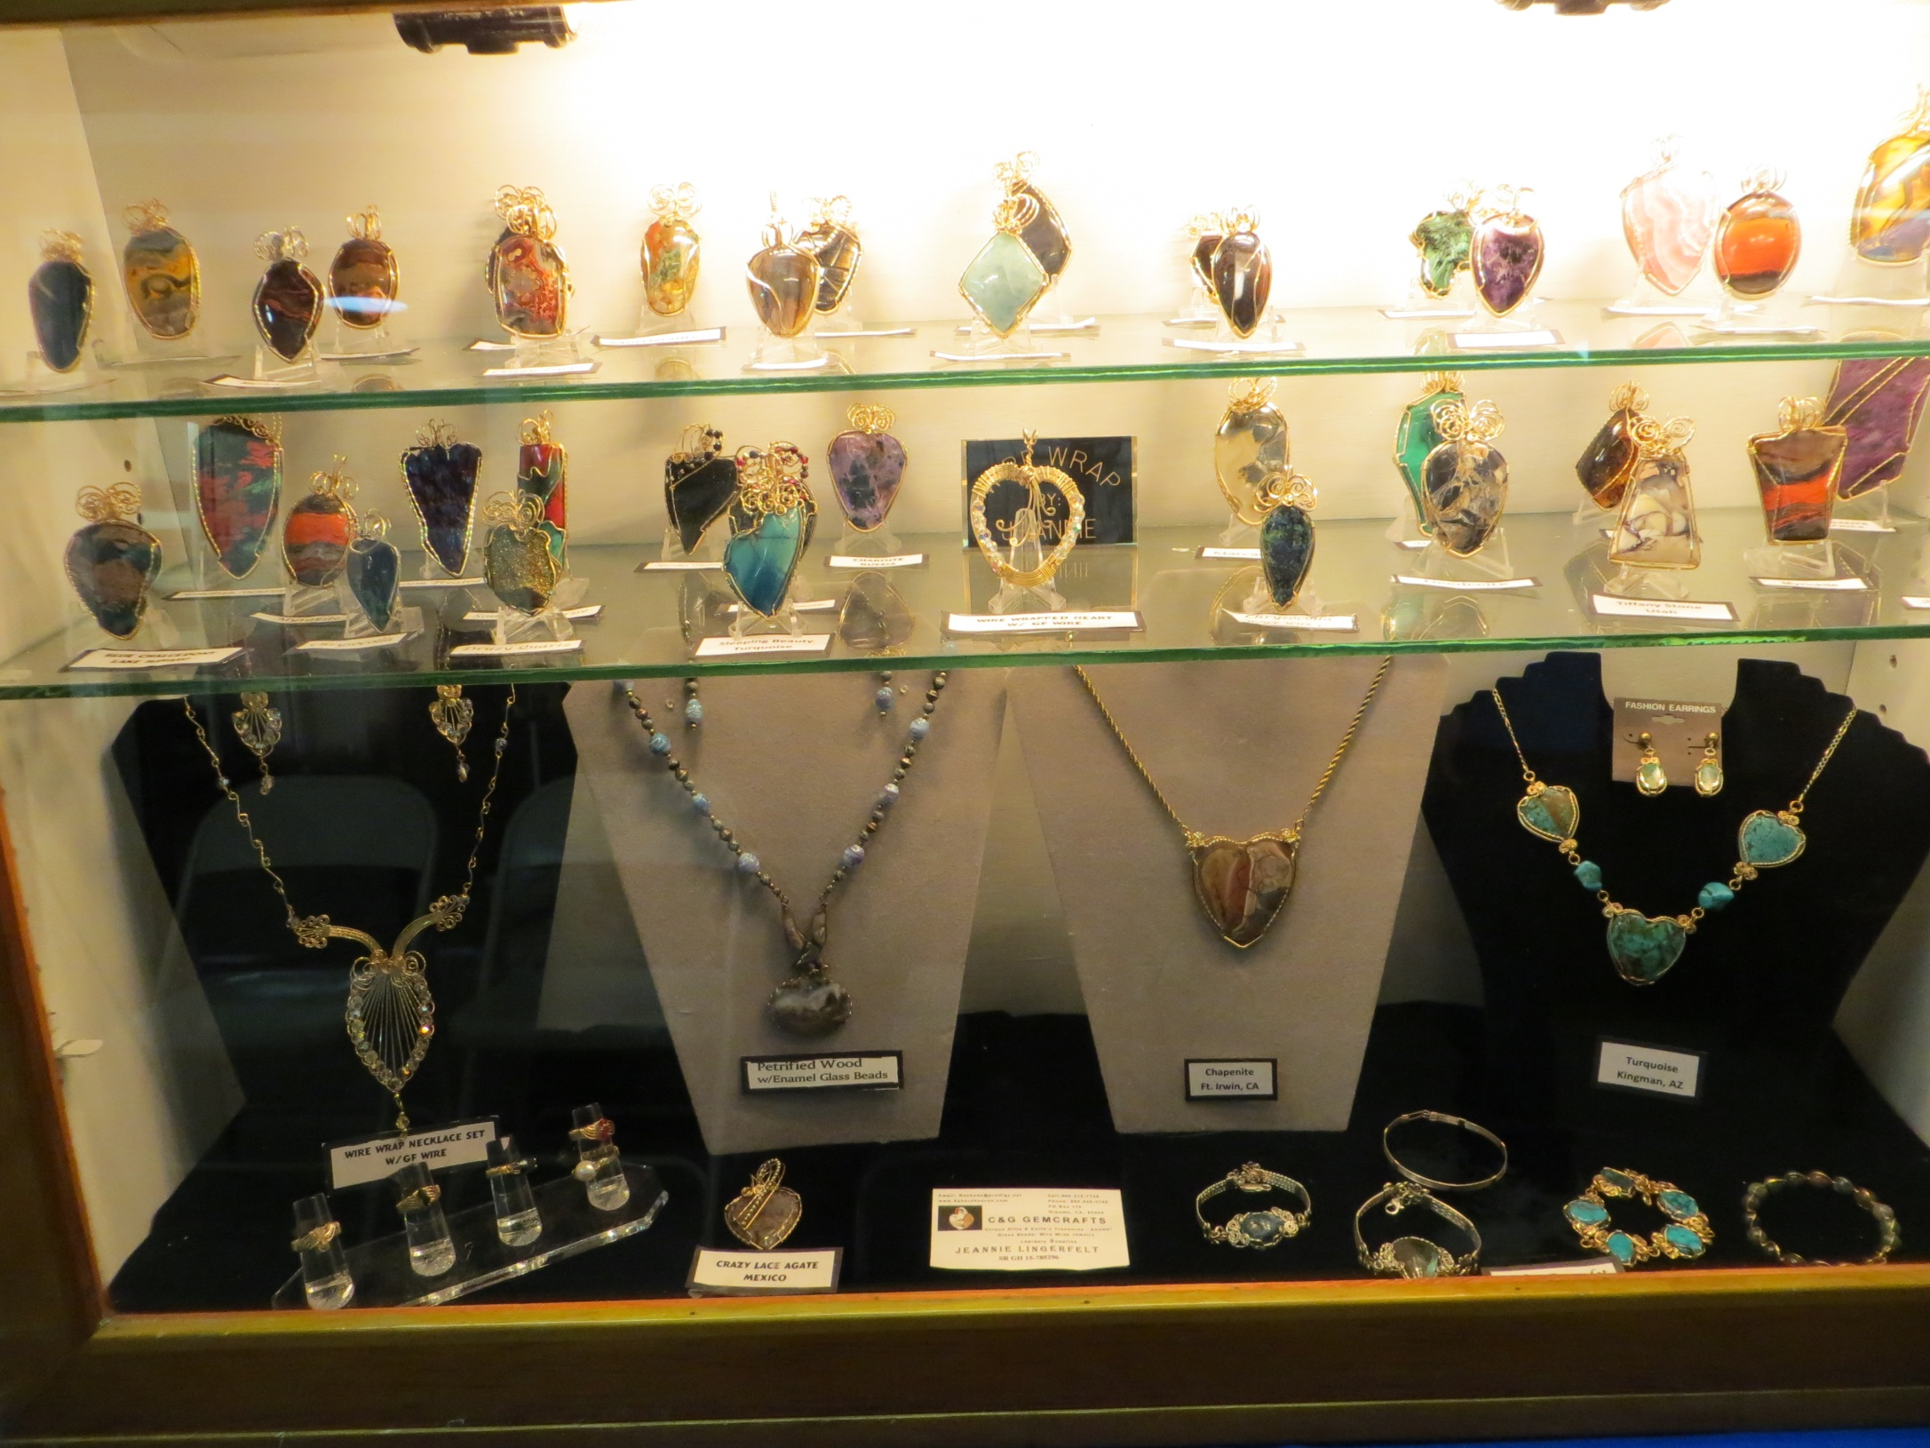

Slide 27
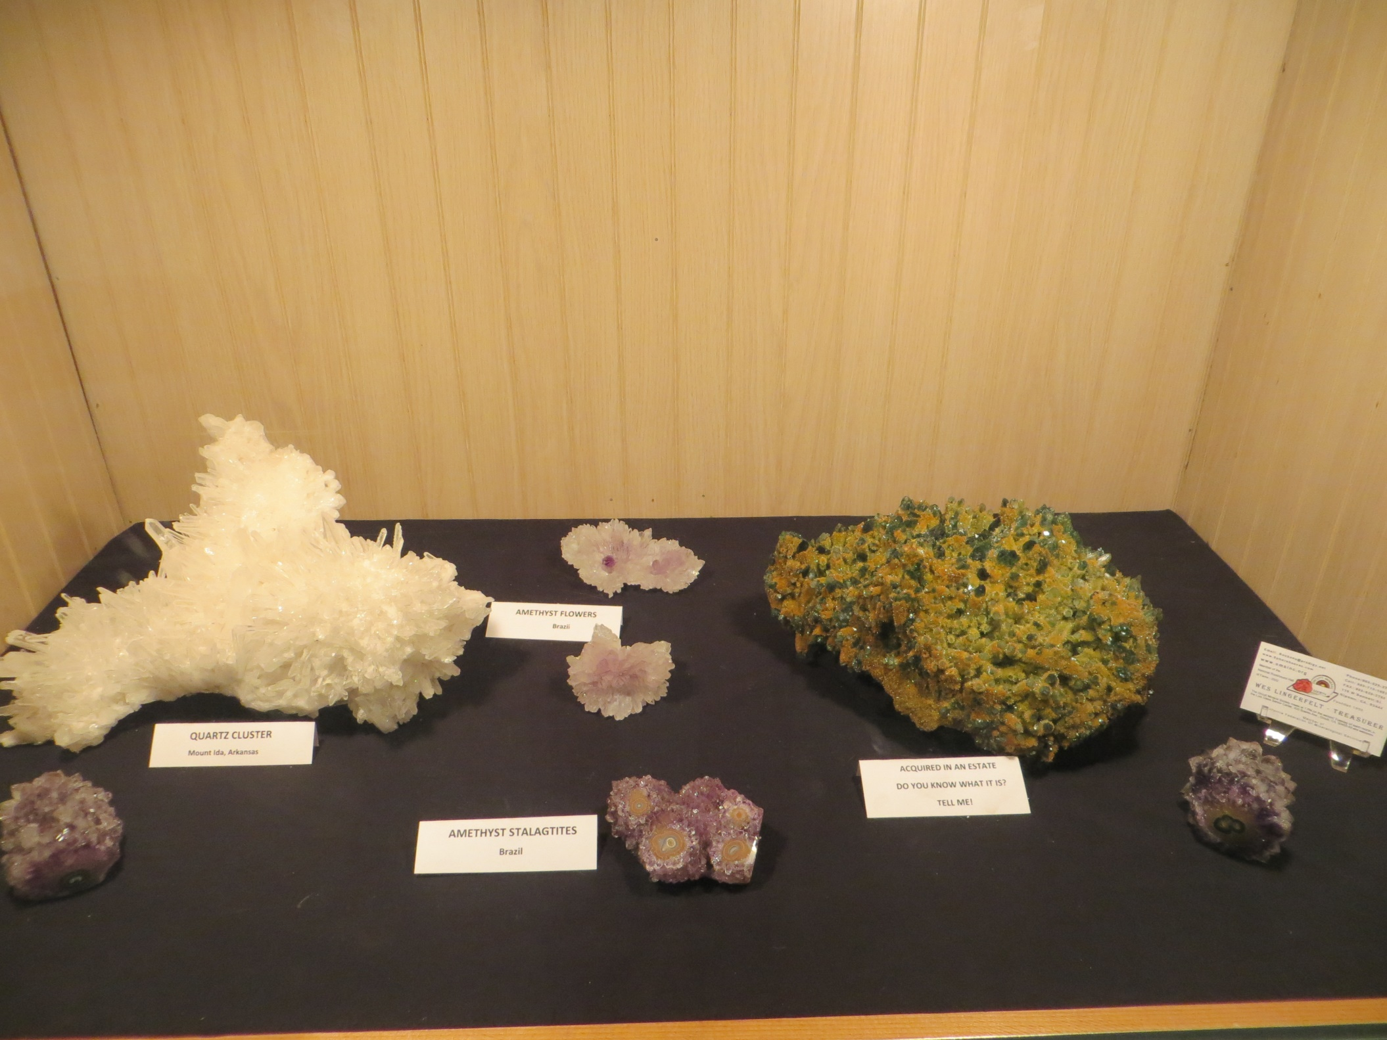

Slide 28
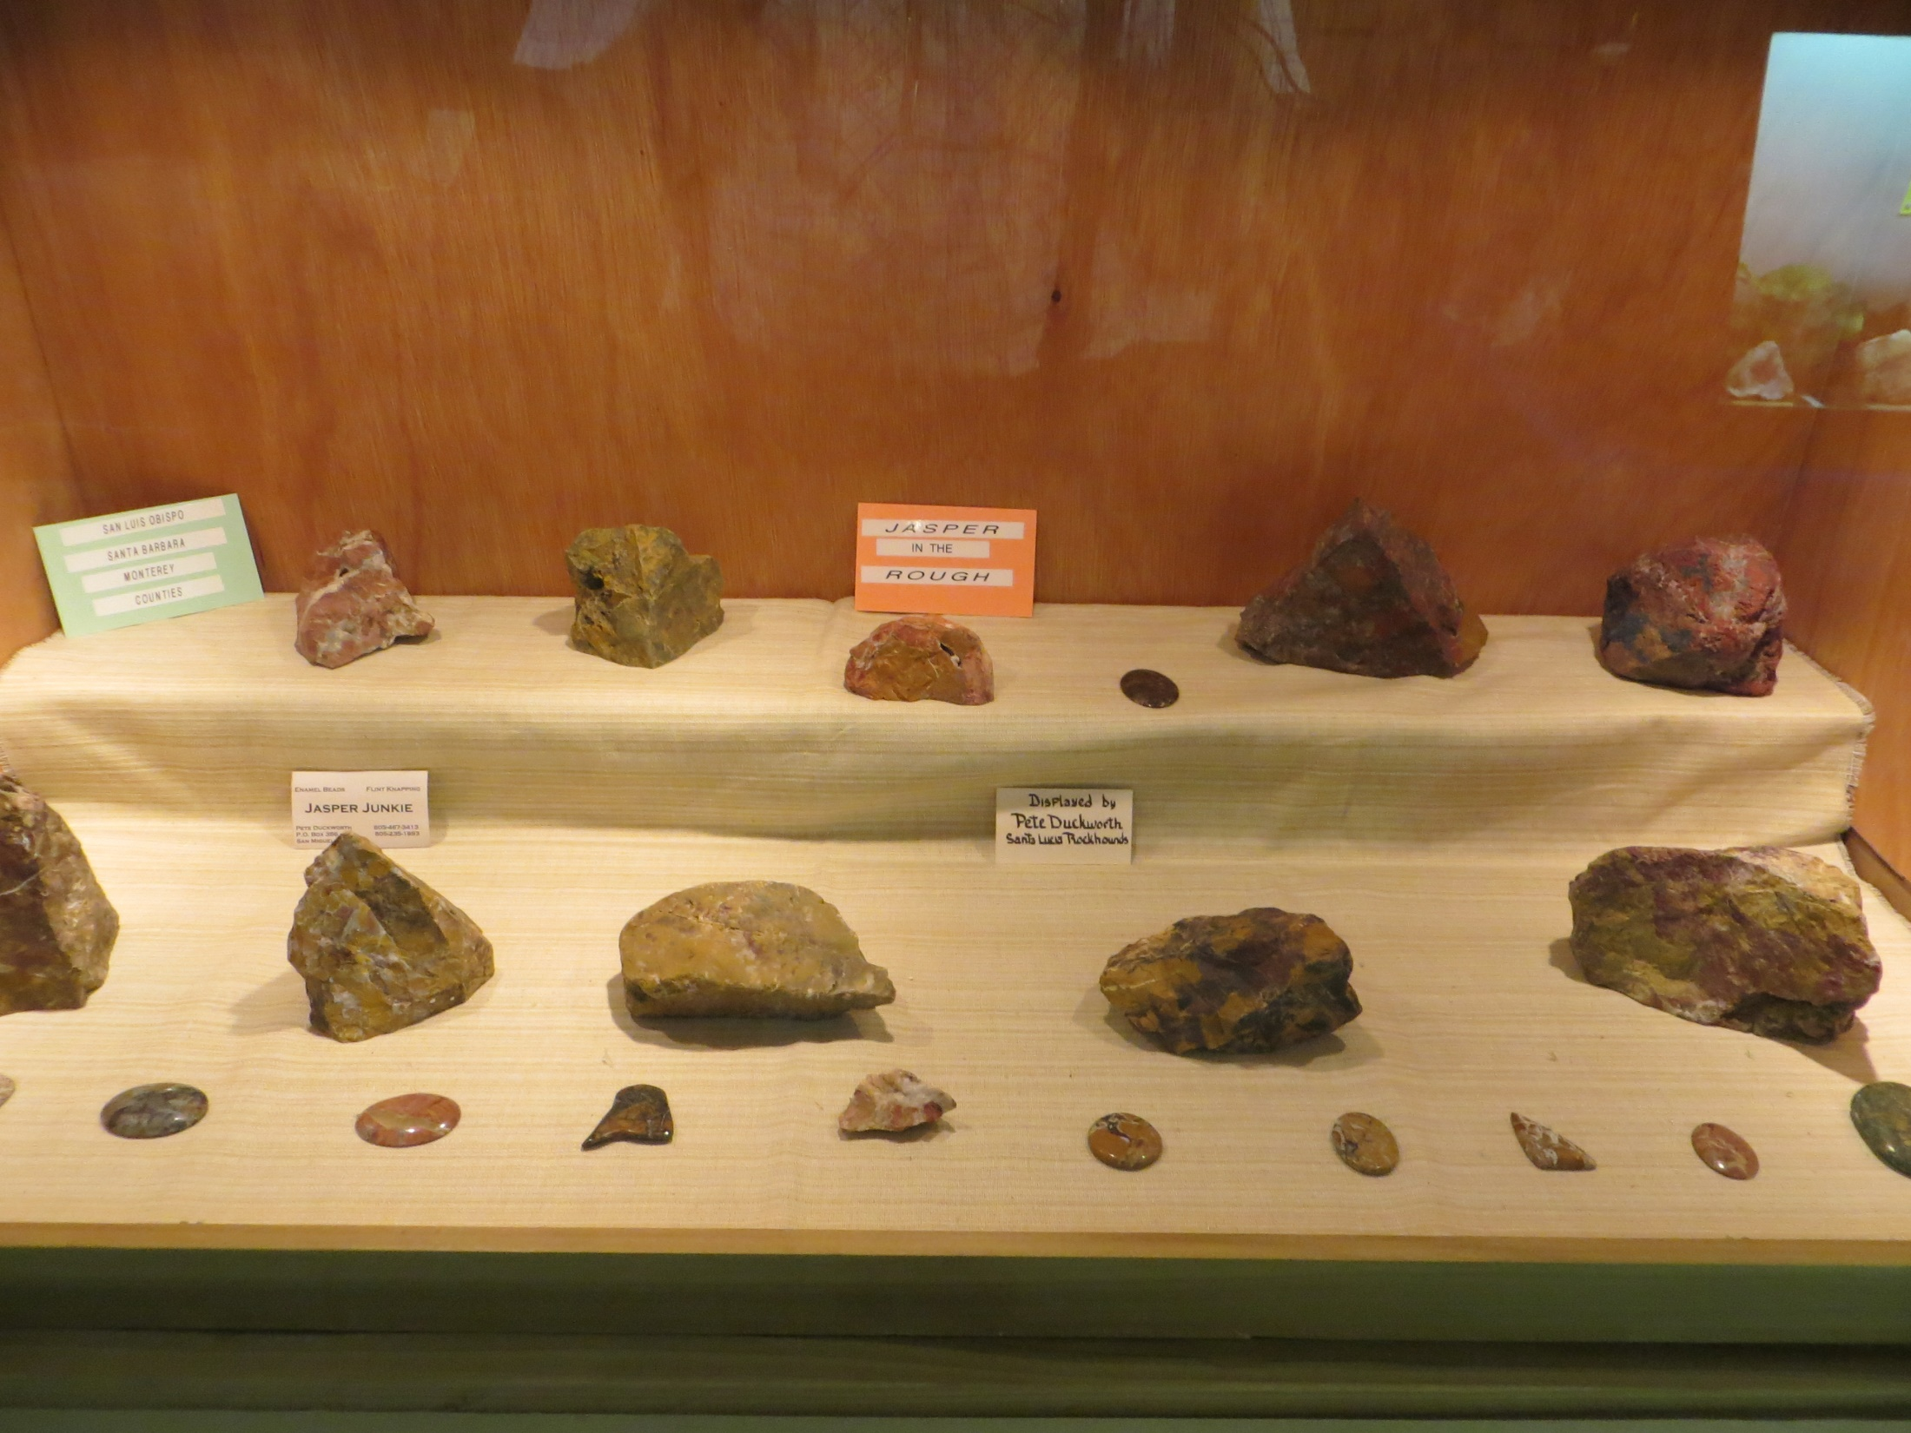

Slide 29
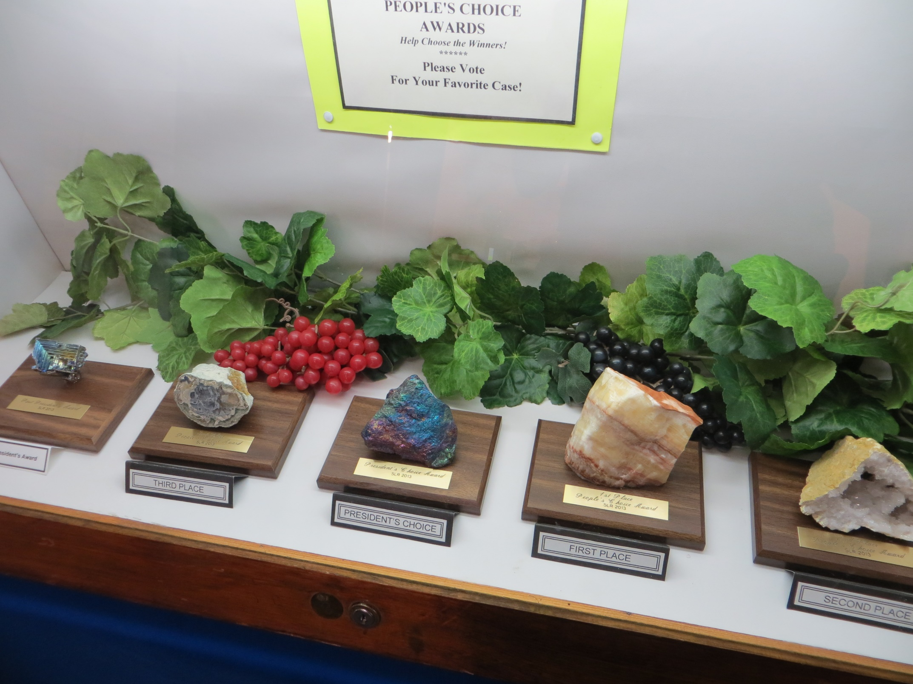

Slide 30
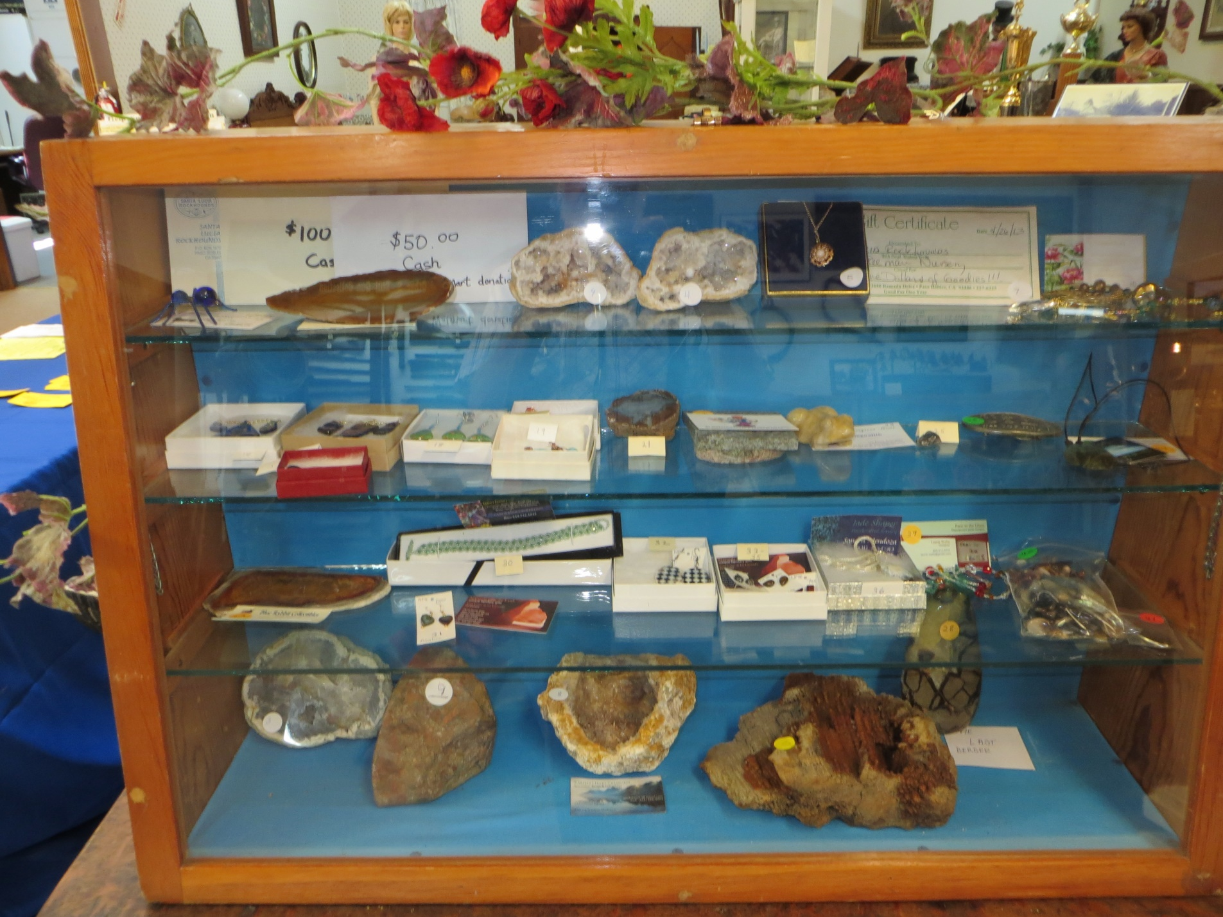

Slide 31
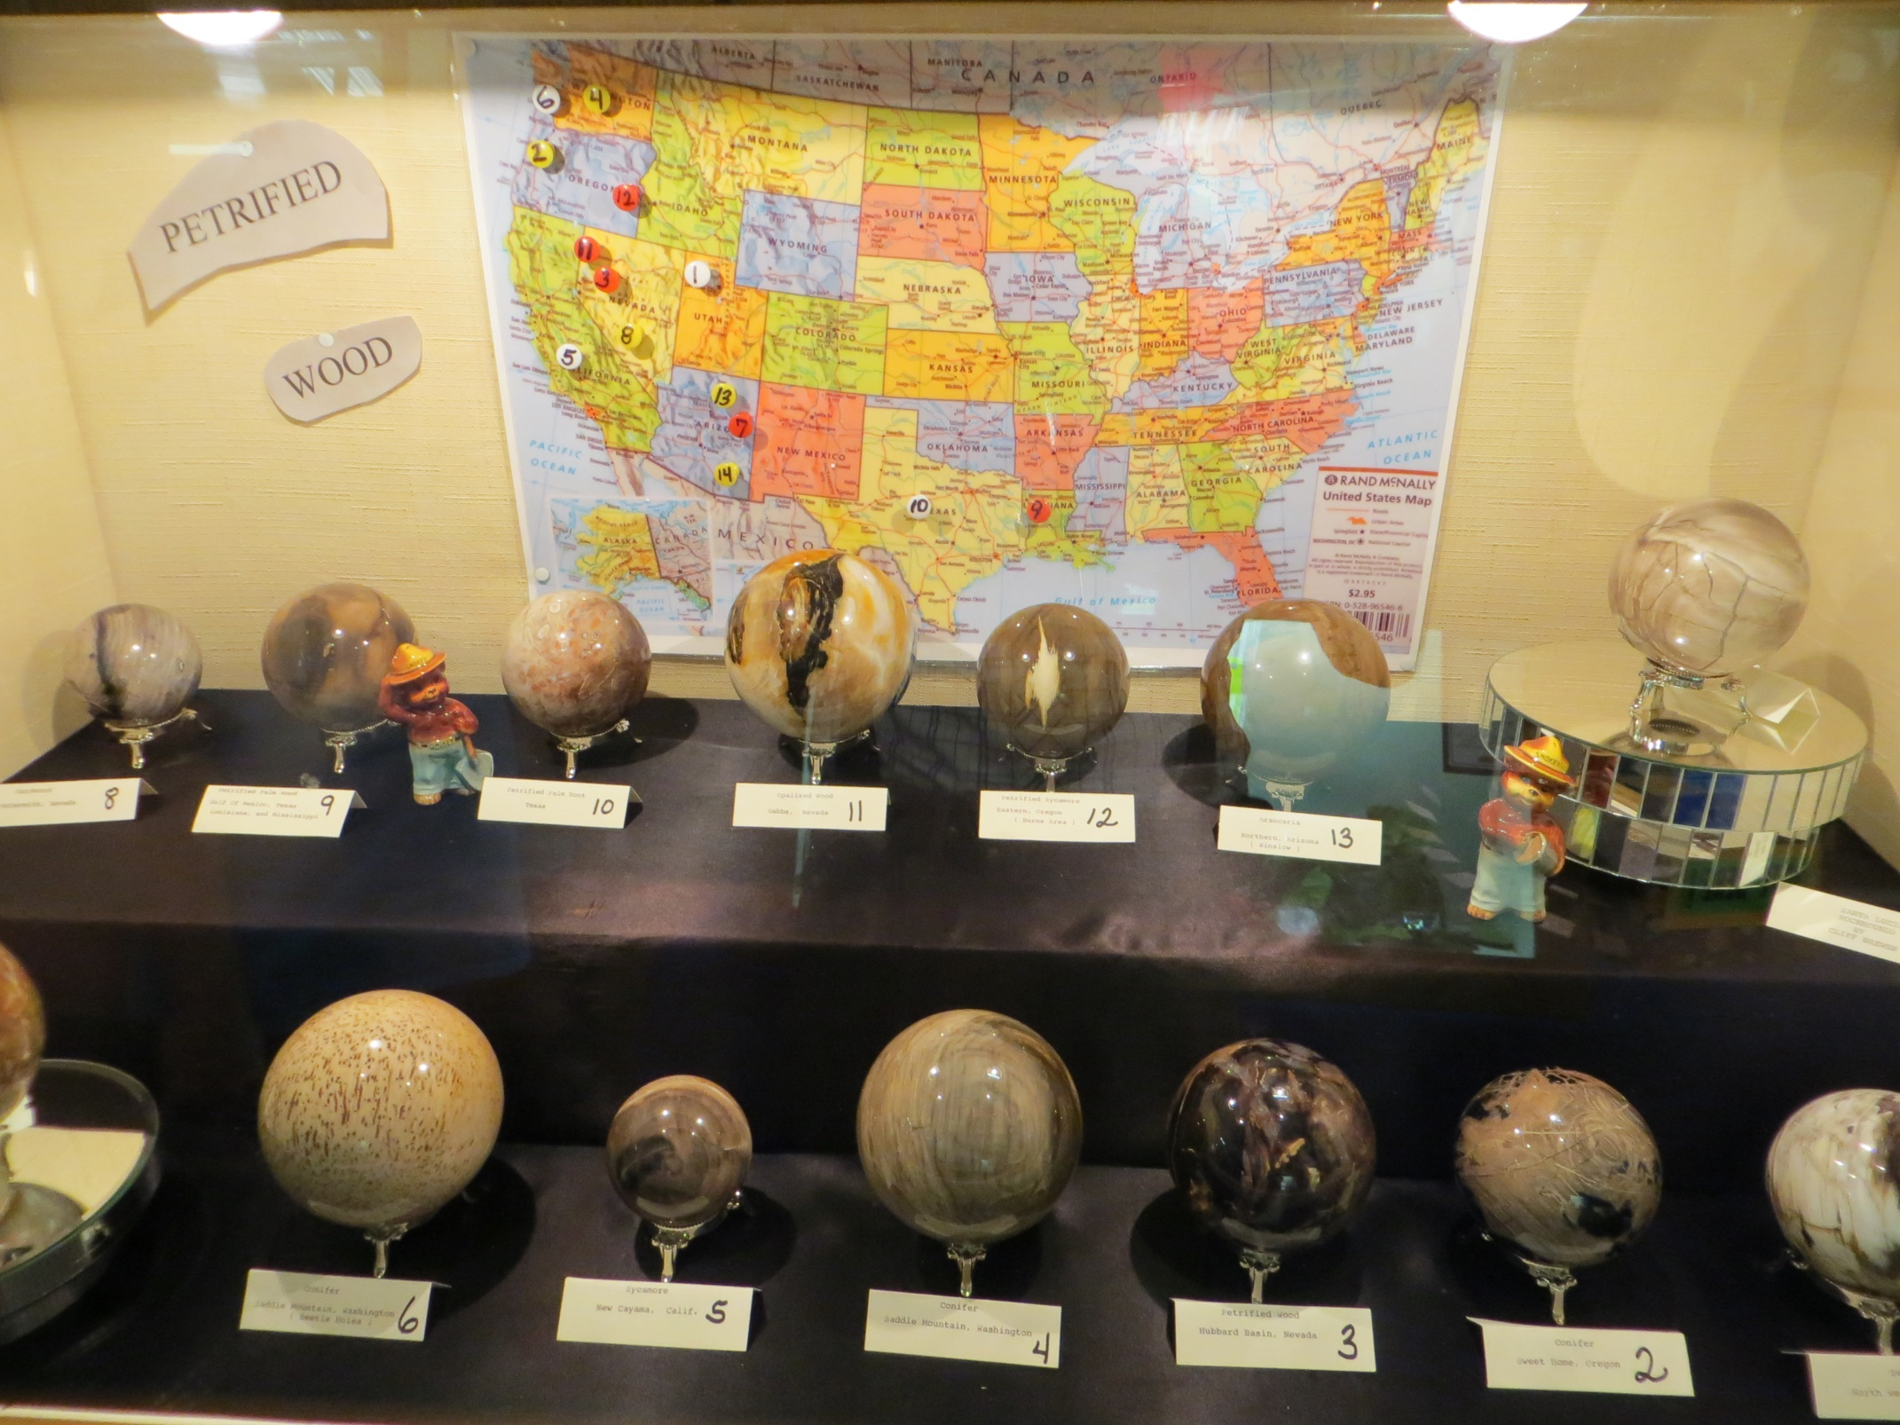

Slide 32
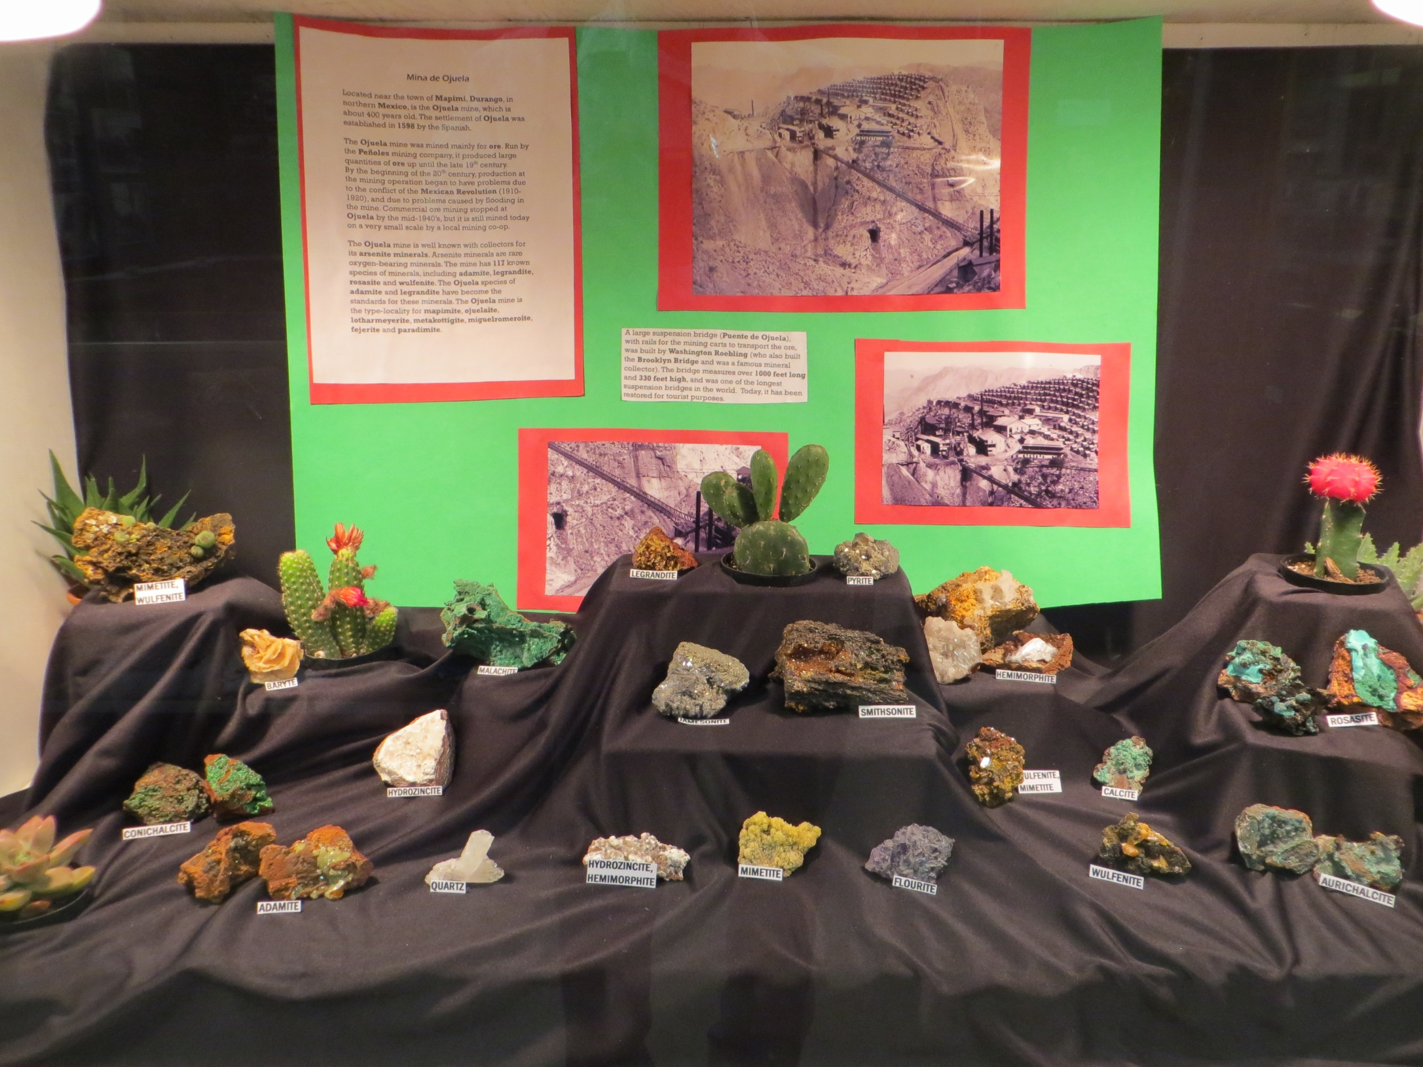

Slide 33
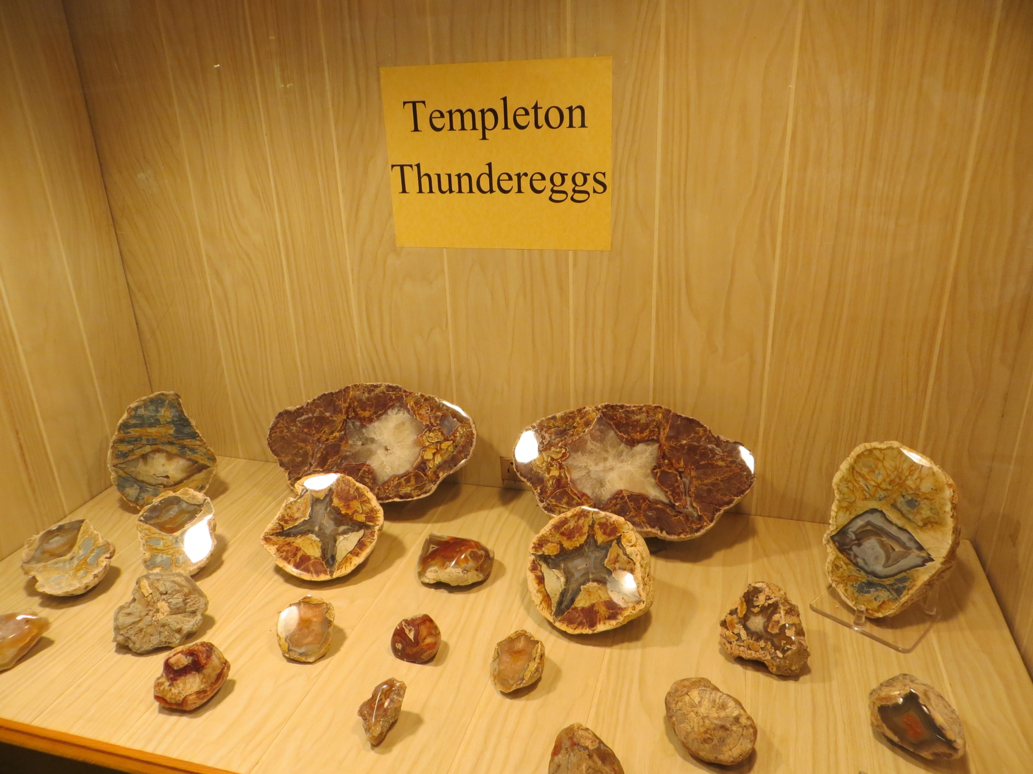

Slide 34
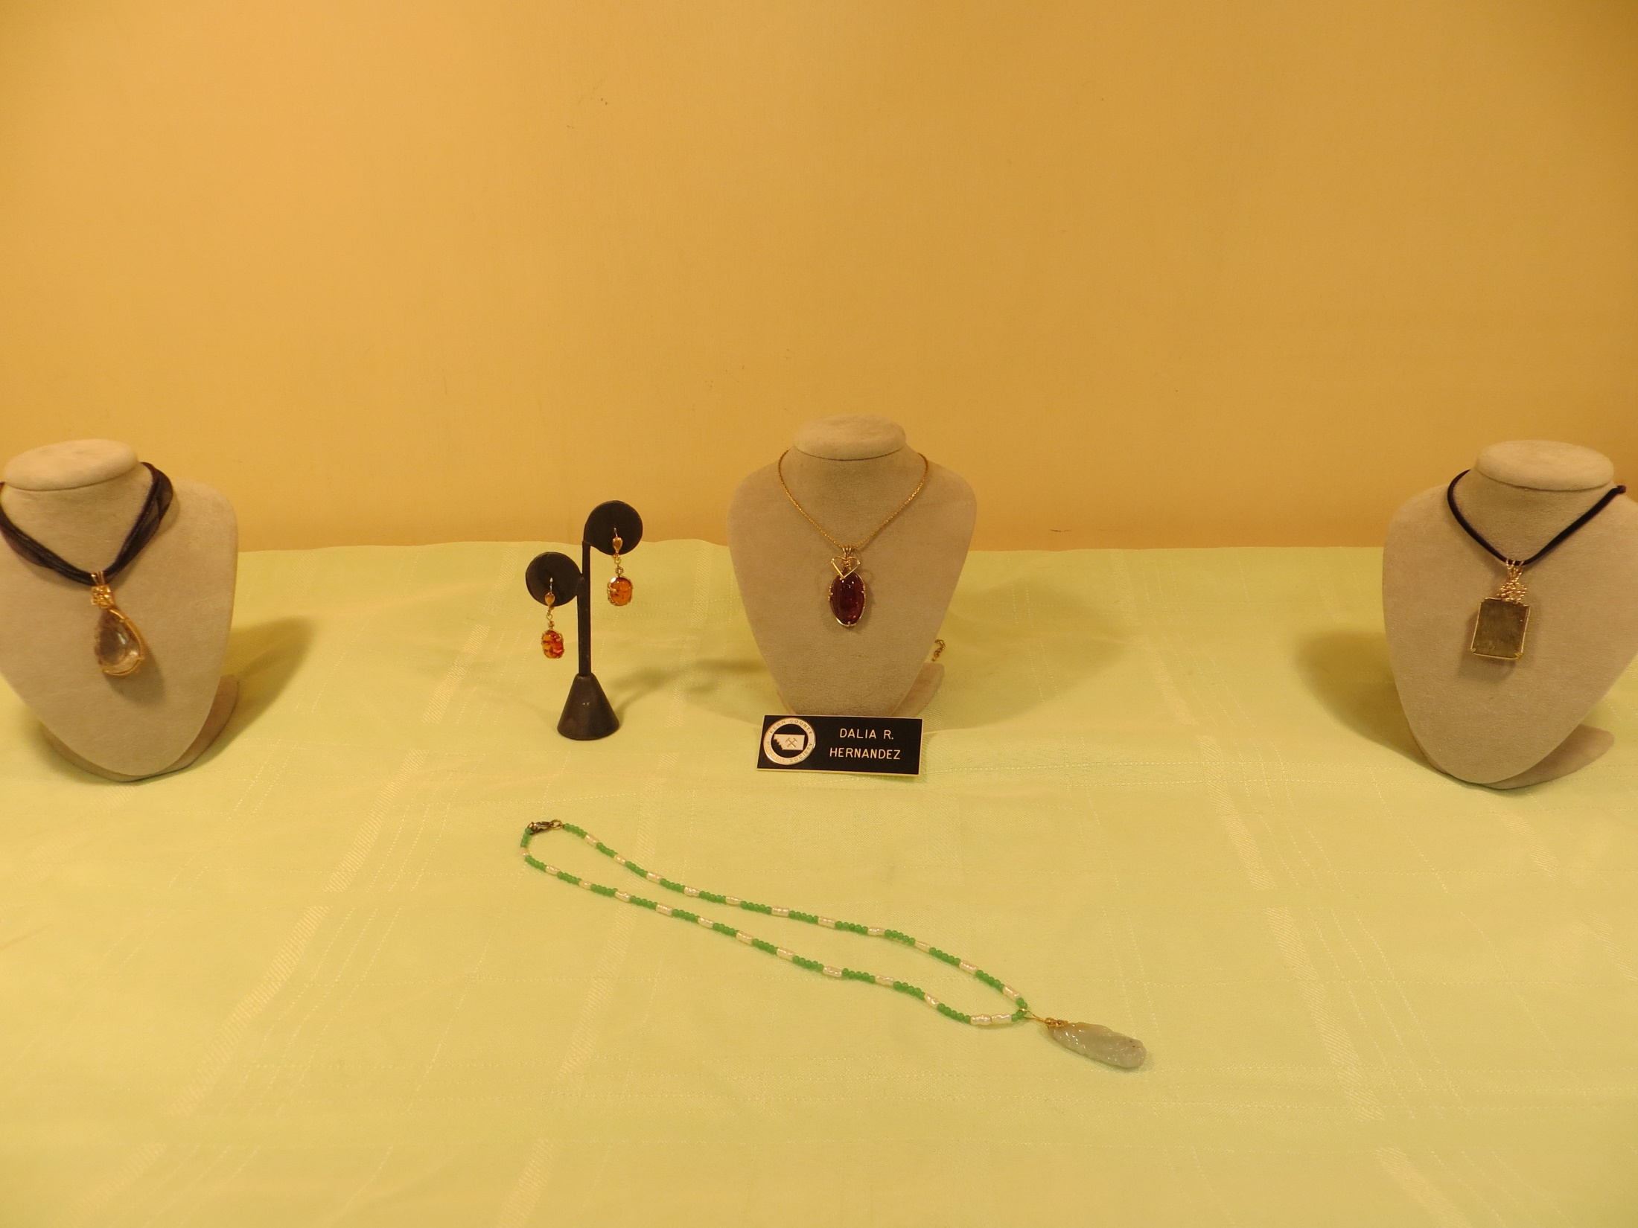

Slide 35
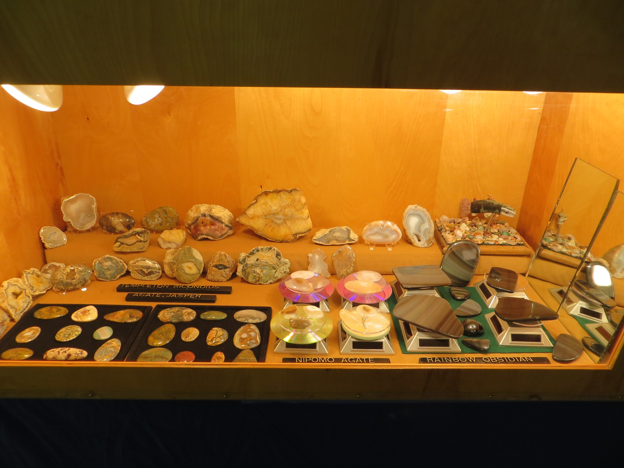

Slide 36
In closing to summarize displaying in a gem show – choose good material, arrange it in the case to highlight the beauty, don’t over crowd it. Make sure labels are correct (Include Provenance if known). Use LED lights if possible.

Slide 37
THE END

